Slide 1
statistics

Slide 2
What is statistics
Statistics is a mathematical science including methods of collectiing, organizing and analyzing data in such a way that meaningful conclusions can be drawn from them. In general, its investigations and analyses fall into two broad categories called descriptive and inferential statistics.

Slide 3
Developing Statistical Thinking
Statistics include numerical facts and figures. For instance:
• The largest earthquake measured 9.2 on the Richter scale.
Men are at least 10 times more likely than women to commit murder.
• One in every 8 Americans is COVID positive.
The study of statistics involves math and relies upon calculations of numbers. But it also relies heavily on how the numbers are chosen and how the statistics are interpreted. For example, consider some scenarios and the interpretations based upon the presented statistics.
1. A new advertisement for Amul's ice cream introduced in late May of last year resulted in a 30% increase in ice cream sales for the following three months. Thus, the advertisement was effective.
2. The more liquor shop in a city, the more crime there is. Thus, liquor shops lead to crime.

Slide 4
Flaw: A major flaw is that ice cream consumption generally increases in the months of June, July, and August regardless of advertisements. This effect is called a history effect and leads people to interpret outcomes as the result of one variable when another variable (in this case, one having to do with the passage of time) is actually responsible.
Flaw: A major flaw is that both increased liquor shops and increased crime rates can be explained by larger populations. In bigger cities, there are both more liquor shops and more crime. This problem refers to the third-variable problem. Namely, a third variable can cause both situations; however, people erroneously believe that there is a causal relationship between the two primary variables rather than recognize that a third variable can cause both.
Hence, the correct Interpretation of the numbers are necessary!!!!

Slide 5
Types of Statistics:
Descriptive statistics deals with the processing of data without attempting to draw any inferences from it. The characteristics of the data are described in simple terms. Events that are dealt with include everyday happenings such as accidents, prices of goods, business, incomes, epidemics, sports data, population data.
Inferential statistics is a scientific discipline that uses mathematical tools to make forecasts and projections by analysing the given data. This is of use to people employed in such fields as engineering, economics, biology, the social sciences, business, agriculture and communications.

Slide 6
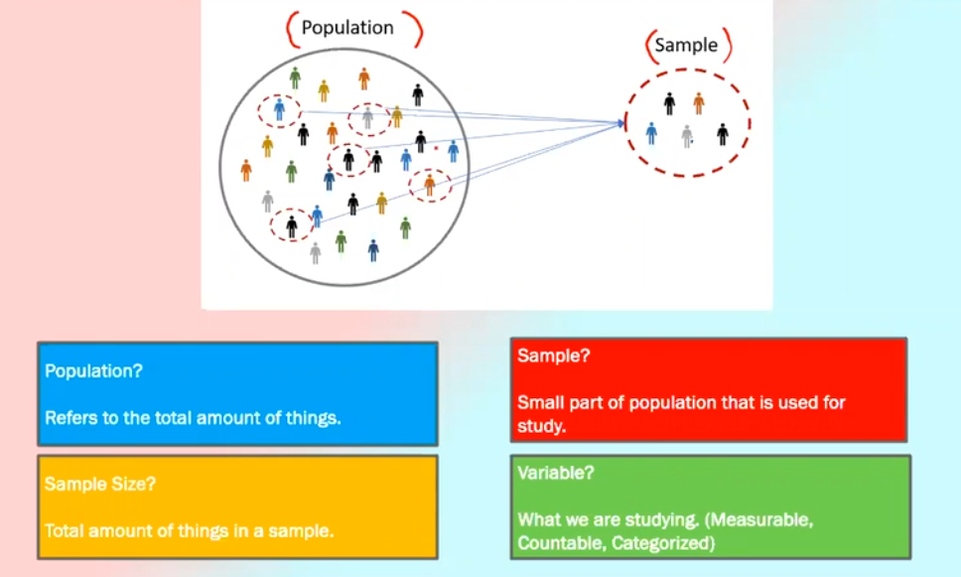

Slide 7
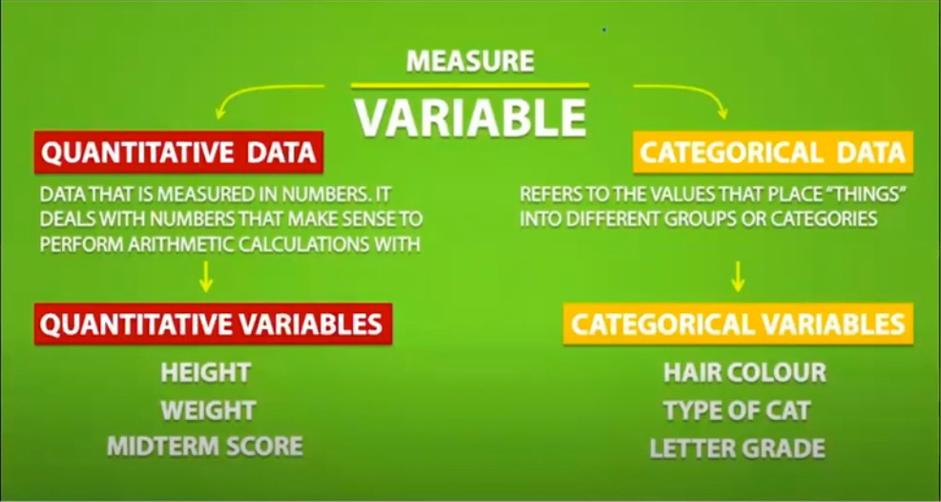

Slide 8
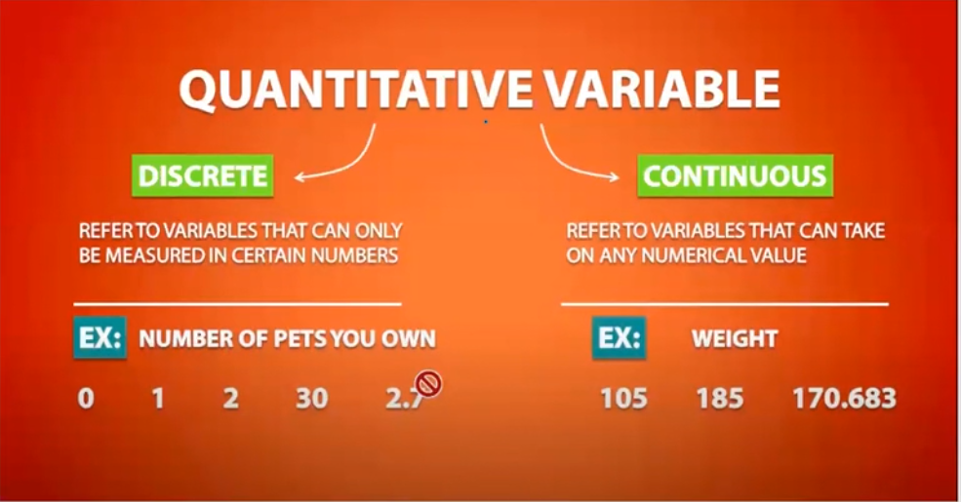

Slide 9
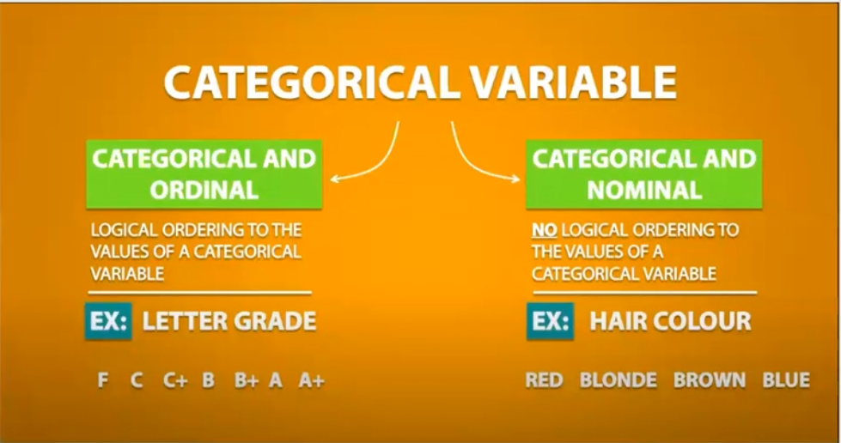

Slide 10
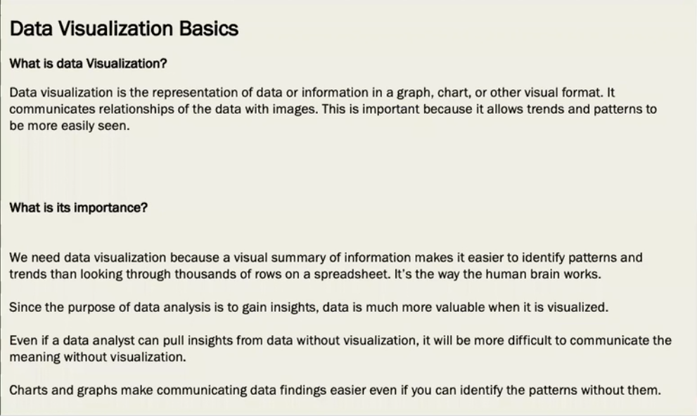

Slide 11
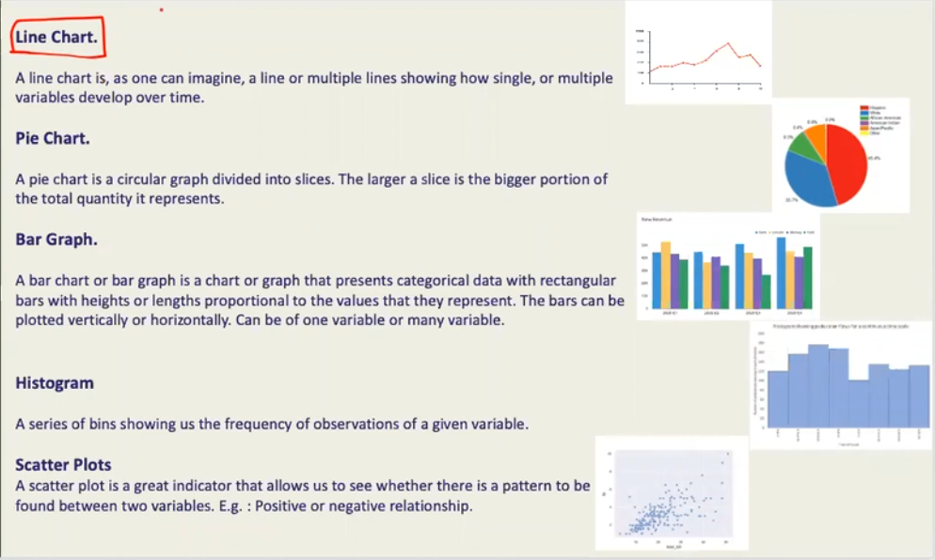

Slide 12
Histogram
A histogram is a graphical representation of the distribution of numerical data. It is an estimate of the probability distribution of a continuous variable. It is a kind of bar graph.
Histograms are commonly used in statistics to show the underlying frequency distribution of a set of continuous data. They provide a visual representation of the data's shape, center, and spread, making it easier to interpret and analyze the data.

Slide 13
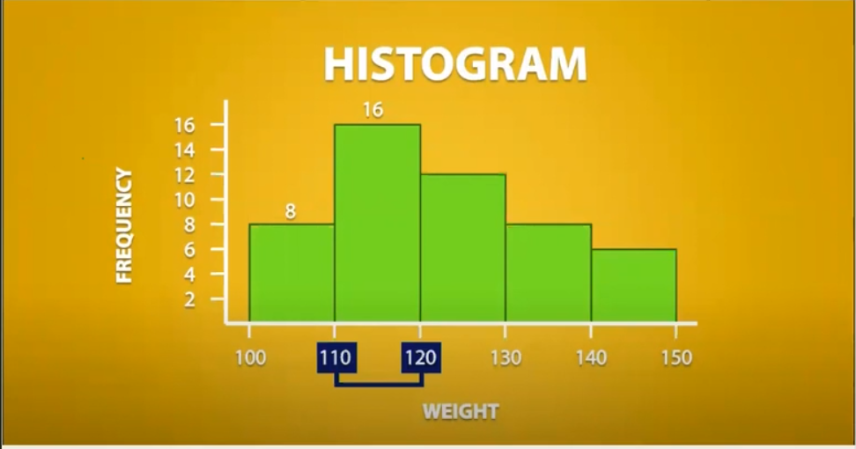

Slide 14
Descriptive Statistics
Descriptive Statistics deals with the processing of data without attempting to draw any inferences from it.
The characteristics of the data are described in simple terms.
Events that are dealt with include everyday happenings such as accidents, prices of goods, business, incomes, epidemics, sports data, population data.
When we give description of data, there can be 3 kinds:
Measures of Central Tendency - Mean, Median and Mode
Measures of Dispersion - Standard Deviation, Variance, Range, IQR (Inter Quartile Range)
Measure of Symmetricity/Shape - Skewness and Kurtosis

Slide 15
1. Measure of Central Tendency
A measure of central tendency is a summary statistic that represents the centre point or typical value of a dataset. These measures indicate where most values in a distribution fall and are also referred to as the central location of a distribution.
1 Mean
Average value of the set of Numbers. Mean is a a number around which a whole data is spread out. Denoted by µ for population mean and for sample mean.X
Example: Find the mean of 5,5,2,6,3,8,9?A:
Mean is (5+5+2+6+3+8+9) / 7 = 38/7 = 5.43
2. Median
Median is the value which divides the data in 2 equal parts i.e. number of terms on right side of it is same as number of terms on left side of it when data is arranged in either ascending or descending order.
(Note: If you sort data in descending order, it won't affect median but IQR will be negative.)
Example: Find the Median of 5,5,2,6,3,8,9?
A: Putting it in ascending order = 2,3,5,5,6,8,9. Hence, Median = Mid Number = 5.
(Note: Median of a even set of numbers can be found by taking the average of the 2 middle numbers.E.g. Median of 2,3,4,7 = average of (3 and 4) = 3.5)
3. Mode
Mode is the term appearing maximum time in data set i.e. term that has highest frequency.
Example: Find the Median of 5,5,2,6,3,8,9?A: Mode = Maximum number of repetition in dataset = 5. Hence, Mode = 5.
(Note: If there is no repetition of data then mode is not present. E.g.: What is the mode of 1,2,3,5,6? A: None i.e. mode is not present.)

Slide 16
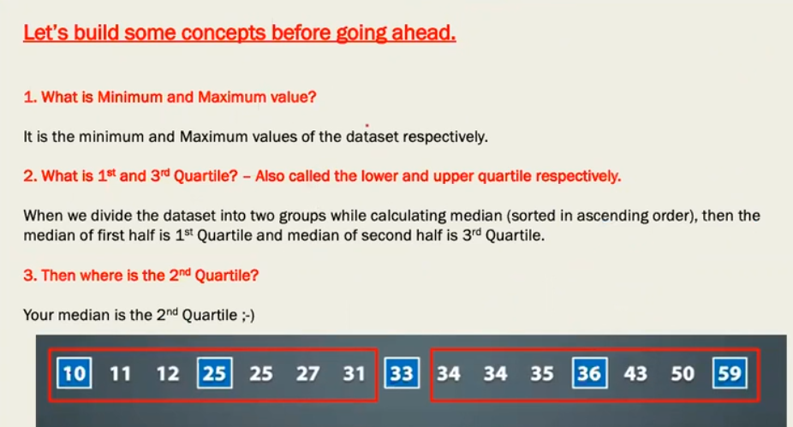

Slide 17
Example
Give the 5 number summary of below data
19, 26, 25, 37, 32, 28, 22, 23, 29, 34, 39, 31

Slide 18
Box plot
box plot, also known as a box-and-whisker plot, is a graphical representation of the distribution of a dataset. It displays the minimum, first quartile, median, third quartile, and maximum of a dataset.
These values are also known as the five-number summary of the data.
Minimum: The smallest number in the dataset not considered an outlier.
First Quartile (Q1): The median of the lower half of the dataset.
Median (Q2 or Second Quartile): The middle value of the dataset, separating the lower and upper halves.
Third Quartile (Q3): The median of the upper half of the dataset.
Maximum: The largest number in the dataset not considered an outlier.
In a box plot:
A box is created from the first quartile to the third quartile, representing the interquartile range (IQR) which contains the middle 50% of the data.
A line (whisker) extends from the box to the minimum and maximum values, indicating the range of the data.
Outliers, if any, are usually plotted as individual points outside the whiskers.
Box plots are useful for comparing distributions between different groups or datasets. They provide a clear summary of the central tendency and spread of the data, making it easy to identify outliers and differences between groups.

Slide 19
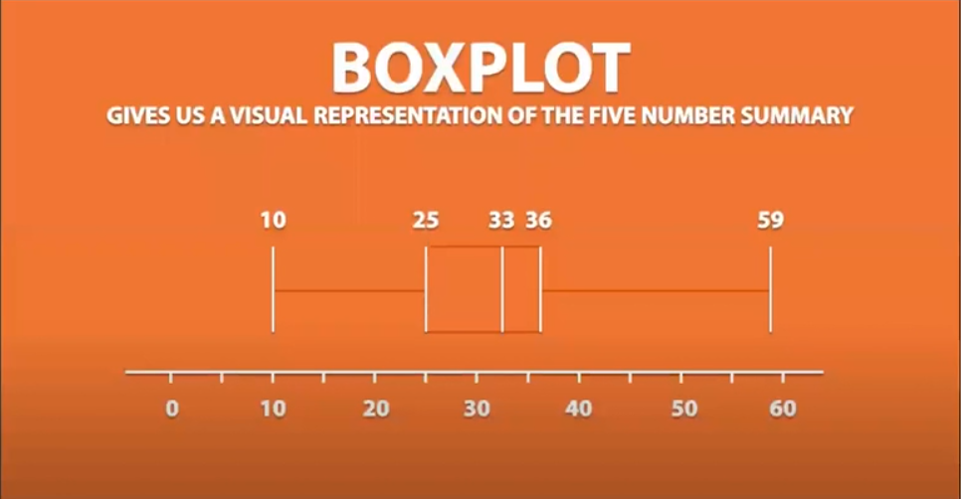

Slide 20
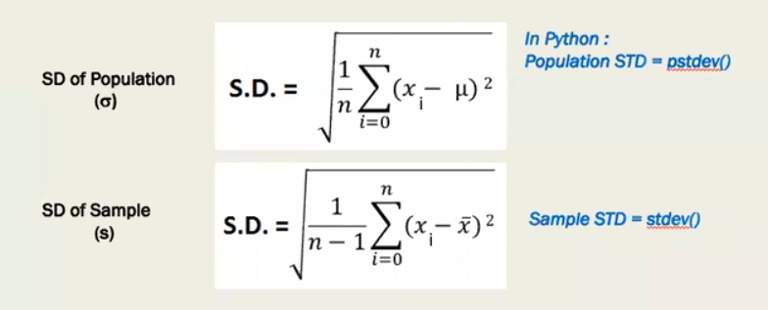
2. Measure of Spread / Dispersion
1. Standard deviation
Standard deviation is the measurement of average distance between each quantity and mean. That is, how data is spread out from mean. A low standard deviation indicates that the data points tend to be close to the mean of the data set, while a high standard deviation indicates that the data points are spread out over a wider range of values.

Slide 21
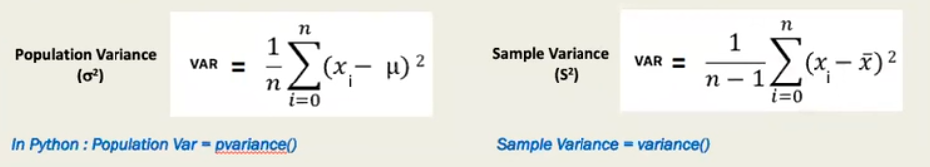
2. Variance
Variance is a square of average distance between each quantity and mean.
It is square of standard deviation
3.Range
Range is one of the simplest techniques of descriptive statistics. It is the difference between lowest and highest value.
Range =Maximum – Minimum
4. IQR (interquartile Range)
Quartiles are value that divide data into quarters.
IQR=Q3-Q1

Slide 22
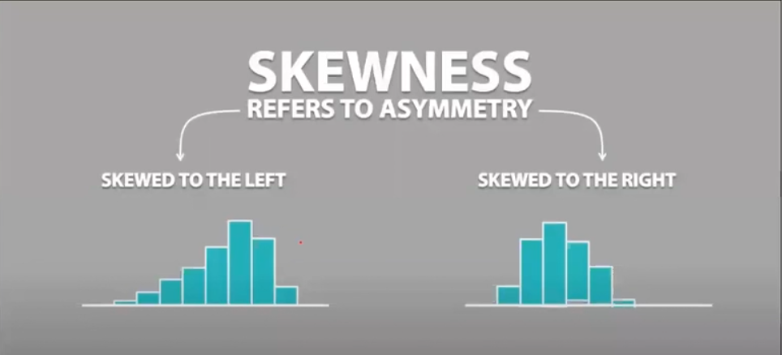
Measure of Symmetricity/Shape - Skewness and Kurtosis
Skewness
Skewness is usually described as a measure of dataset’s symmentry – or lack of symmentry.
A perfectly symmentrical data set will have a skewness of 0.

Slide 23
curtosis

Slide 24
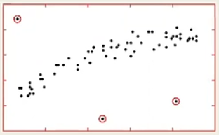
Outliers
﻿
What is outlier?
An outlier is an observation that lies an abnormal distance from other values in a random sample from a population. In a sense, this definition leaves it up to the analyst to decide what will be considered abnormal.
Common Causes of Outliers
1. Data entry errors (human errors)
2. Measurement errors (instrument errors)
3. Experimental errors (data extraction or experiment planning/executing errors)
4. Intentional (dummy outliers made to test detection methods)
5. Data processing errors (data manipulation or data set unintended mutations)
6. Sampling errors (extracting or mixing data from wrong or various sources)
7. Natural (not an error, novelties in data)

Slide 25
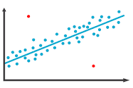
Common Methods of determining an outlier
Sort the data and see for the extreme value
Plotting –Boxplot, Scatterplot
IQR method
Z-Score Method
Why do we need to treat outliers?
Outliers can impact the results of the analysis and statistically modeling in a drastic way.

Slide 26
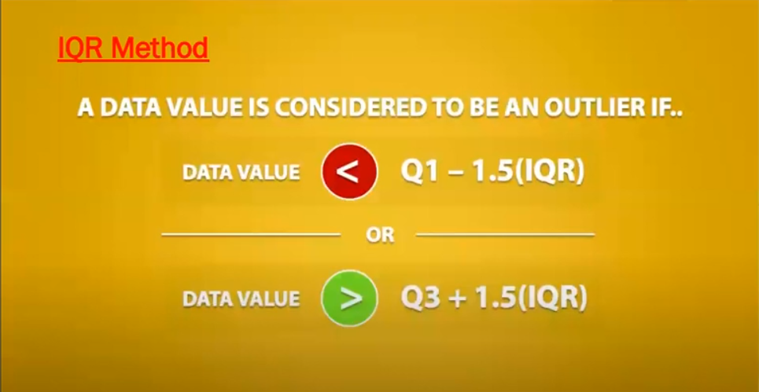

Slide 27
Exercise
Identify the outliers from the below dataset, using IQR Method

Slide 28
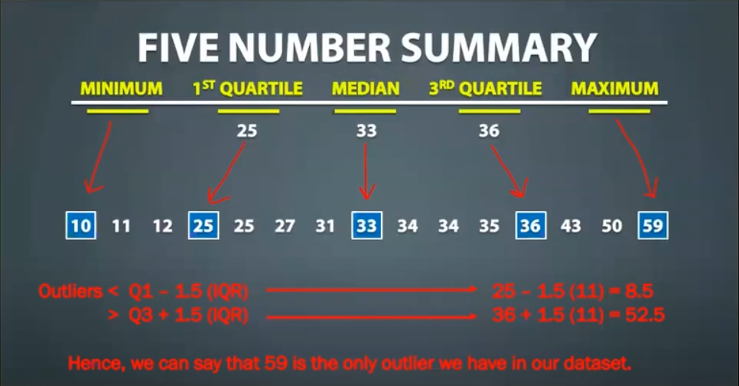

Slide 29
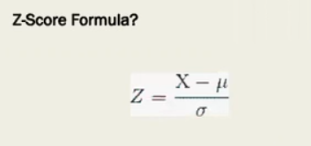
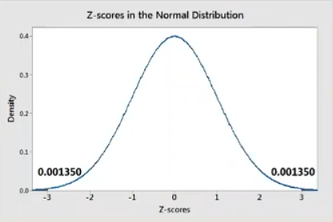
Z-Score Method
What is Z-Score?
Z-scores can quantify the unusualness of an observation.
Z-scores are the number of standard deviations above and below the mean that each value falls (assuming normal distribution).
For example, a Z-score of 2 indicates that an observation is two standard deviations above the average while a Z- score of -2 signifies it is two standard deviations below the mean.

Slide 30
Exercise
Consider the below dataset. Find out the outlier using z-score method
1, 2, 2, 2, 3, 1, 1, 15, 2, 2, 2, 3, 1, 1,2

Slide 31
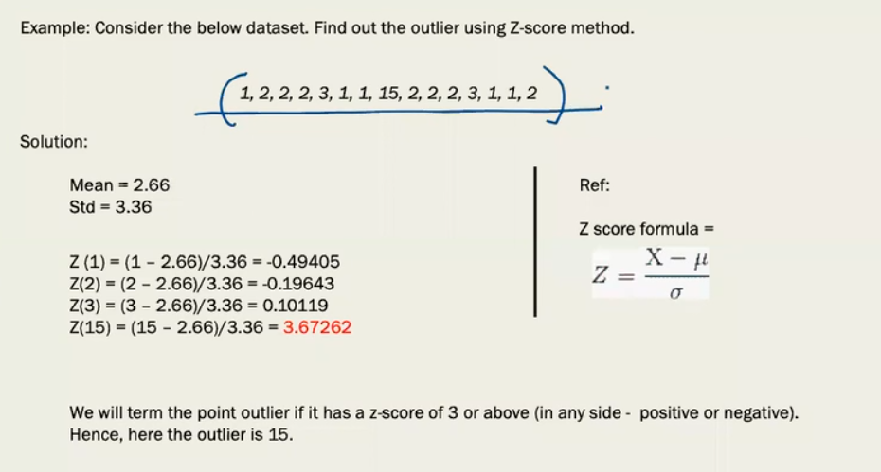

Slide 32
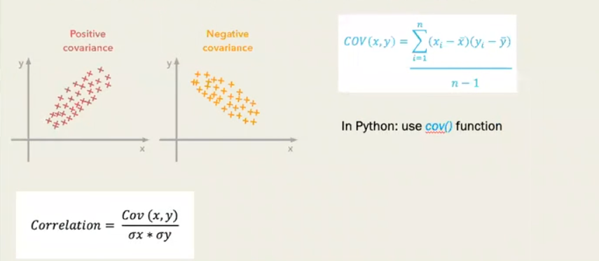
Covariance
It is a metric which is used to measure the direction of relationship between two random variables and evaluates how two variables change together.
Difference between variance and covariance lies in the fact that variance measures how one variable varies, however, covariance measures how two variables vary with respect to each other. In other words, variance tells the covariance of variable with itself.
Covariance can take up any value from (-) infinity to (+) infinity and gives the direction of relationship between two variables. One important point to note here is that it only measures how two variables change together.

Slide 33

What is Correlation?
Correlation is a statistical technique to depict the relationship between 2 variables - strength and direction. We measure the correlation with the help of Correlation Coefficient.
For example, height and weight are related; taller people tend to be heavier than shorter people.
What is Correlation Coefficient?
The Pearson's correlation coefficient (r) is a measure that determines the degree to which the movement of two variables is associated. The value of Correlation Coefficient lies between -1 and 1.
Formula: (Pearson's Correlation Coefficient)- Standard Formula
In Python: DataFrame.corr(method='pearson')
(n = sample size, and Sx, Sy are the standard deviation of samples x and y. X-bar and y-bar are the respective means of x and y samples whereas Xi and Yi are sample points of X and Y respectively.)

Slide 34
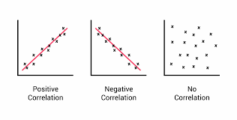
Positive and Negative Correlation
1. Correlation Coefficient greater than zero indicates a positive relationship 2. while a value less than zero signifies a negative relationship 3. and a value of zero indicates no relationship between the two variables being compared.

